Slide 1
Datawarehouse and Business Intelligence Model for a Super Store
Members:
Mohit Bhagchandani (10427221)
Manan Satra (10423227)
Ria Echhpal (10431037)
Namita Powar (10430951)
Marielle Nwana (10440572)
Jimmy Mickel (10443465)

Slide 2
Company Profile
The name of our company is Super Store and we are a leading supermarket retail chain serving Americans since 1900.
We are the most trusted brand in consumer goods due to our deep rooted expertise in the consumer market.
Since inception, we have expanded our business to 50 cities with more than 200 branches.
Mission Statement: Your daily needs made accessible and affordable.
Business Model:
Wholesale and retail services
Loyalty and membership offers
Everyday low pricing
2 day flash sales
Piggly wiggly stocking

Slide 3
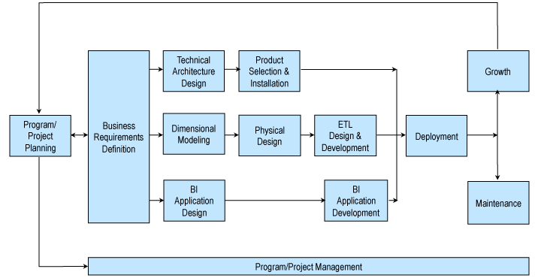
Business Dimensional Lifecycle
Ref: https://www.kimballgroup.com/data-warehouse-business-intelligence-resources/kimball-techniques/dw-bi-lifecycle-method/

Slide 4
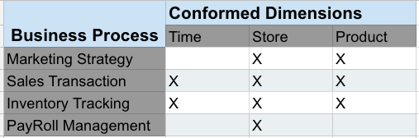
High Level Bus Matrix

Slide 5
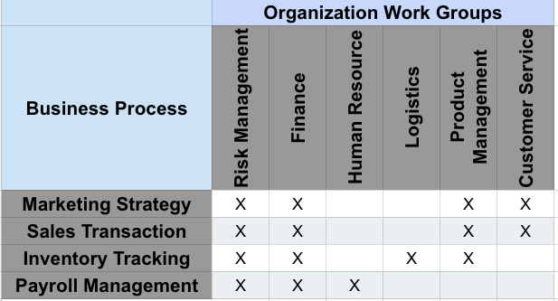
Opportunity Matrix

Slide 6
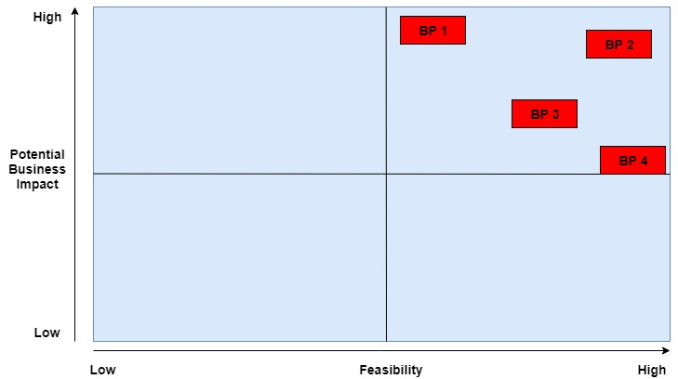
Prioritization Matrix
BP 1: Marketing Strategy
BP 2: Sales Transactions
BP 3: Inventory Tracking
BP 4: Payroll Management

Slide 7
Steps to Dimensional Modelling
Choose a Business Process and its data
A Business Process is chosen as a Fact Table
Design the DW by the Business Process not the Business Unit
Super Store – Tracking sales and inventory
Choose the Grain of the Business Process
Represents one row of the Fact Table
Choose the lowest possible grain, aggregate to higher levels
Super Store – Each Product, Day in the Fact table
Choose Dimensions of the Business Process
Dimensions explain Fact tables
Represent Query Entry-Points into the Star Schema
Each Dimension has several Attributes
Super Store – Time, Customer, Product
Choose the Measured Facts
Facts are numeric fields that populate each fact table record
Super Store - Product bought, product sold, stores, time of transaction, promotion applied

Slide 8
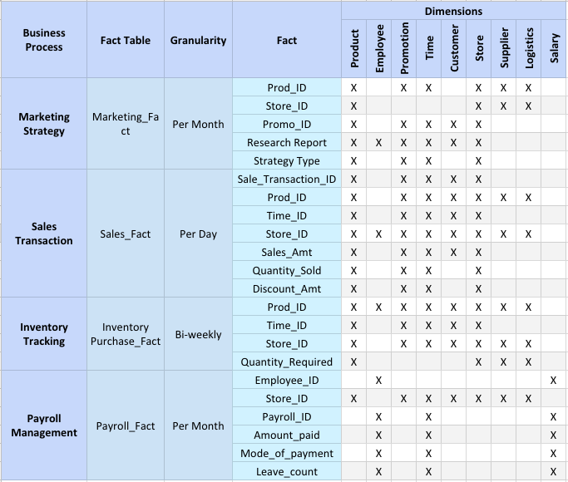
Detailed Bus Matrix

Slide 9
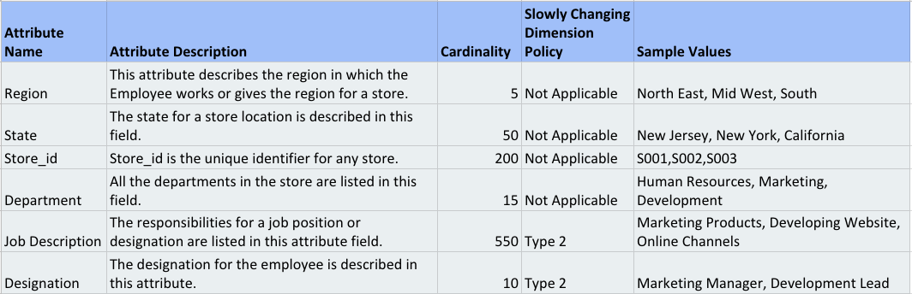
Dimensional Table Detailed Diagram

Slide 10
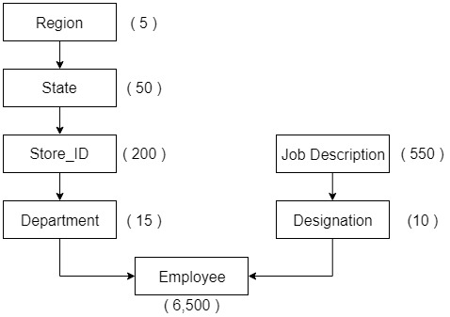
Dimension Table Detailed Diagram
Slowly Changing DImensions
Designation
Job Description
State

Slide 11
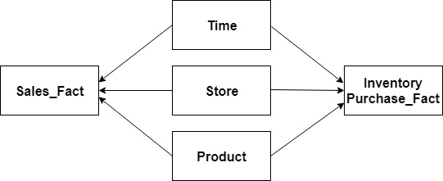
Conformed Dimension
Definition:
The dimensions which are shared between two different fact tables are known as conformed dimensions

Slide 12
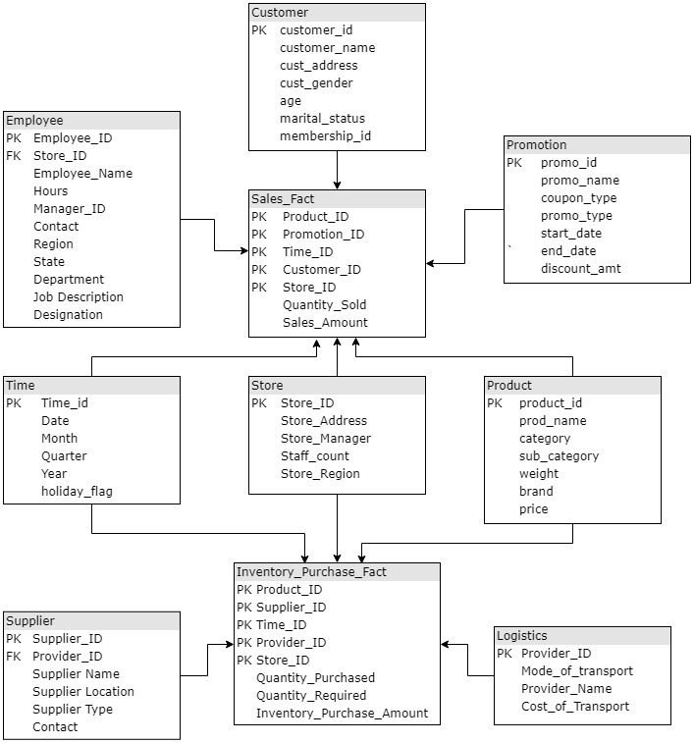
Logical Fact Table

Slide 13
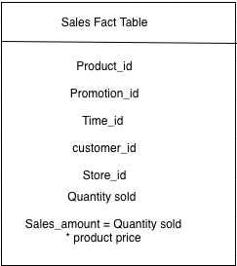
Detailed Fact Table Design

Slide 14
Transformation Rules
Rule Type | Description
Direct Move | Data in the source field is copied directly into the destination field with no manipulation of the data.
Customer Profitability Code | Customer Profitability Code will concatenate Customer ID and Sum of all customer profits with format xx-yyyyy-zz.zz
Date | Date Formatting for Order/Shipping dates shall be transformed to format MM/DD/YYYY w/ leading zeros deleted
Null | If source data is null, then destination data will also be null.
Notes:
Identify representative transformation rules.

Slide 15
Aggregate Tables for Sales
Aggregation Tables for Sales
Business Process | Type | Fact Table | Grain | Included Variables
 |  |  |  | Sale_Transaction_ID | Prod_ID | Time_ID | Store_ID | Sales_Amt | Quantity_Sold | Discount_Amt
Analyze monthly performance for each store | One-Way | Sales_Fact | Store_Month |  |  | x | x | x | x | x
Analyze monthly performance for each Product | One-Way | Sales_Fact | Store_Month |  | x | x |  | x | x | x
Analyze monthly performance for each Product at each store | Two-Way | Sales_Fact | Store_Product_Month |  | x | x | x | x | x | x
Notes:
Design one aggregate table. Identify and explain if it’s 1-way, 2-way, etc

Slide 16
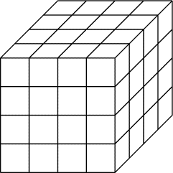
Cube Design for Sales Store_Product_Month Aggregation
Design for Two-Way Store & Product Performance Table
Dimension | Description | Sparsity
Sales_Amt, Discount_Amt, Quantity_Sold | Fact | Always dense, aggregated at the store or product dimension
Time | Dimension | Always dense: By year, month, bi-weekly, or daily
Product | Dimension | High Sparsity: Not every product will have sales
Store | Dimension | Low Sparsity: Not every store will have product sales for each month, i.e. if a store is closed for renovations
Product 1
Product 2
Product 3
Product 4
Product
Store A Store B Store C Store D
Store
Jan. Feb. March April
Time
Notes:
Design one cube (MDDB). Identify the facts, dimensions and, for each dimension,
whether it’s dense or sparse and why, and aggregation levels (dimension hierarchies).

Slide 17
User Roles And Availability Definitions
User Role | Availability | Value
Executive | Tableau Production Server, Workbooks emailed | Visual Summary Of Sales/Profitability By Category
Manager | Tableau Production Server, Workbooks emailed | Salesperson Performance Analysis, Product/Category Sales Performance
Standard User | Tableau Production Server | Product Sales Reports

Slide 18
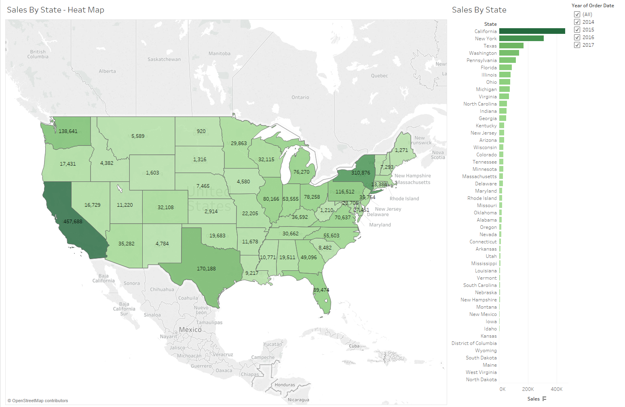
Executive Dashboard - Sales By State

Slide 19
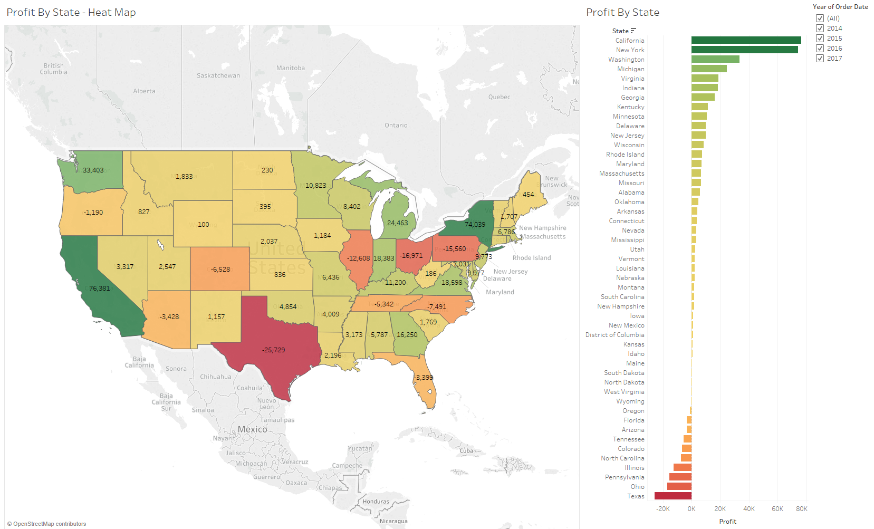
Executive Dashboard - Profit By State

Slide 20
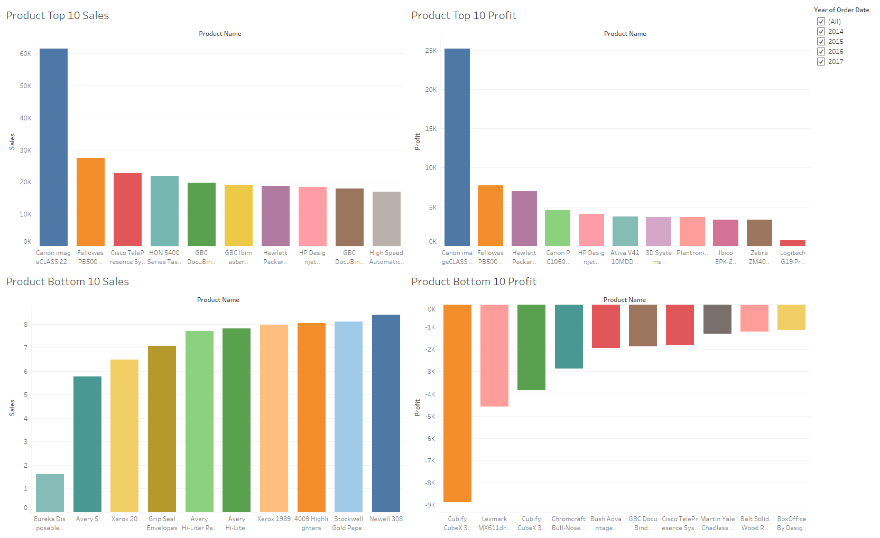
Product Sales & Profitability Dashboard - Executive Summary

Slide 21
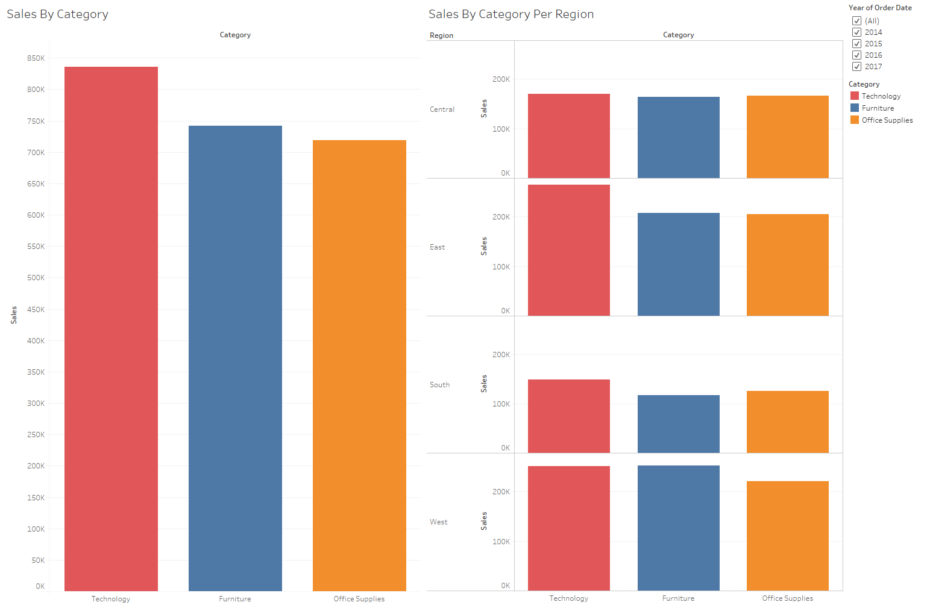
Sales By Category And Per Region - Executive Summary

Slide 22
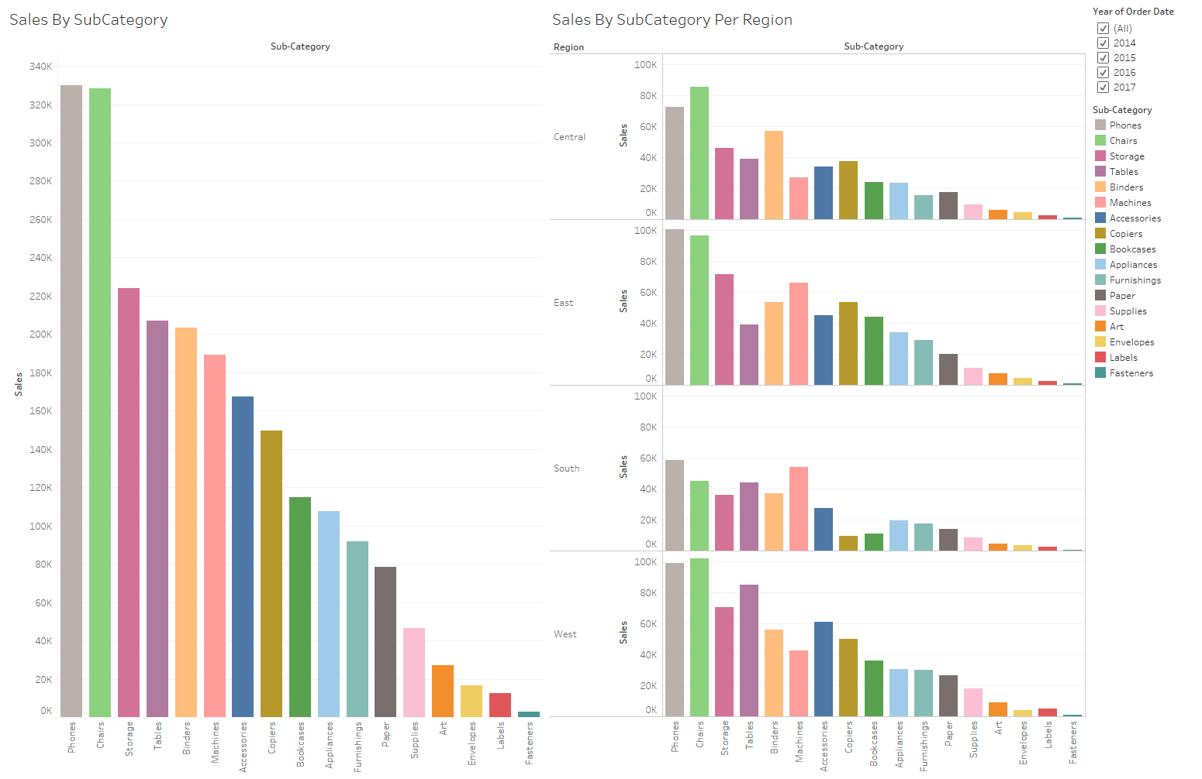
Sales By Sub-Category And Per Region

Slide 23
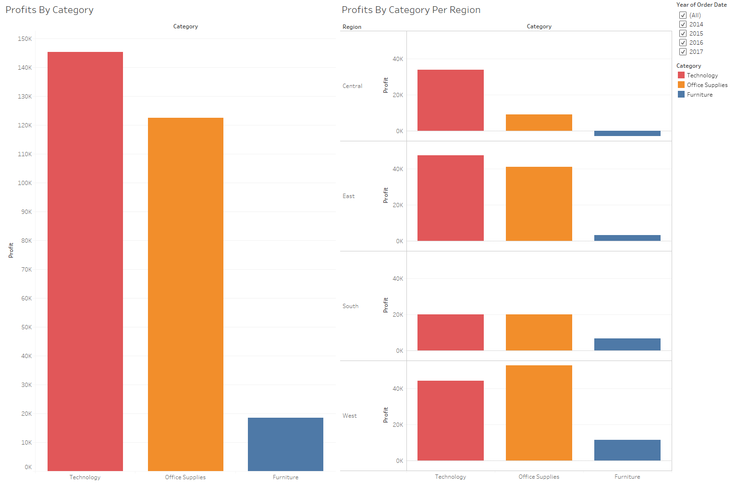
Profits By Category And Per Region - Executive Summary

Slide 24
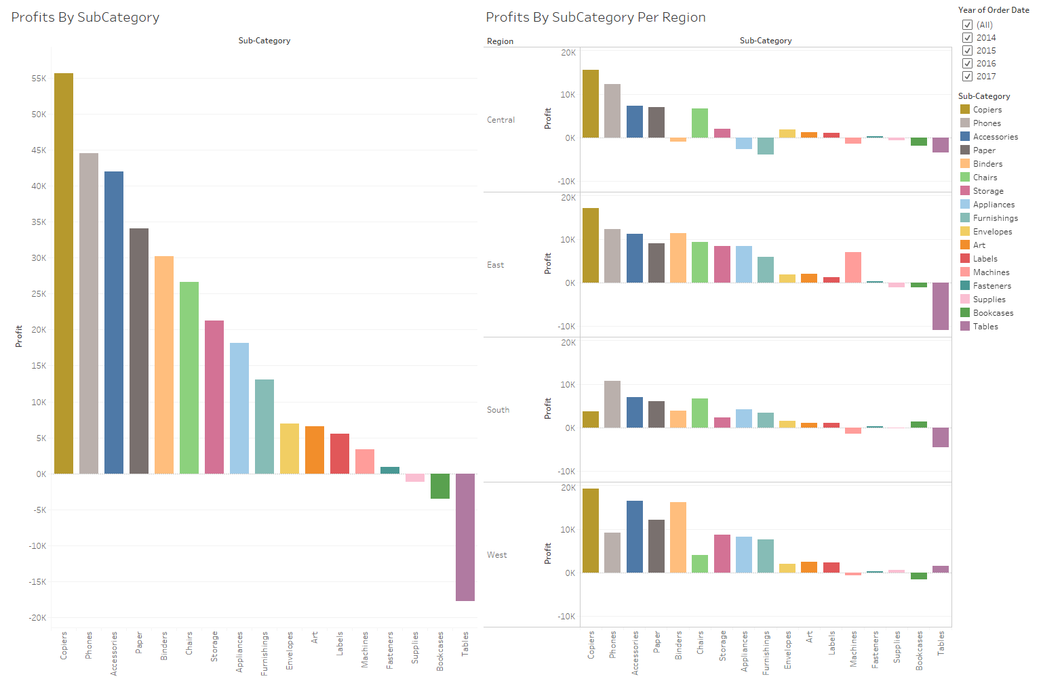
Profits By Sub-Category And Per Region

Slide 25
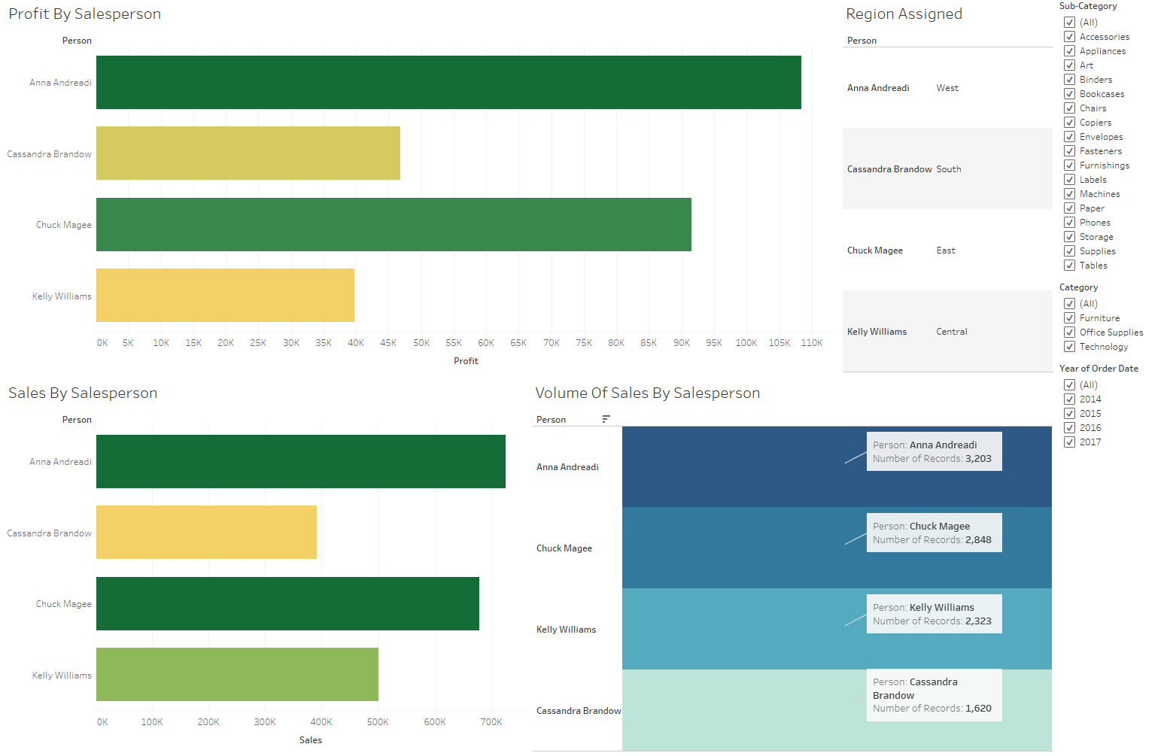
Sales Manager Dashboard - Salesperson Statistics

Slide 26
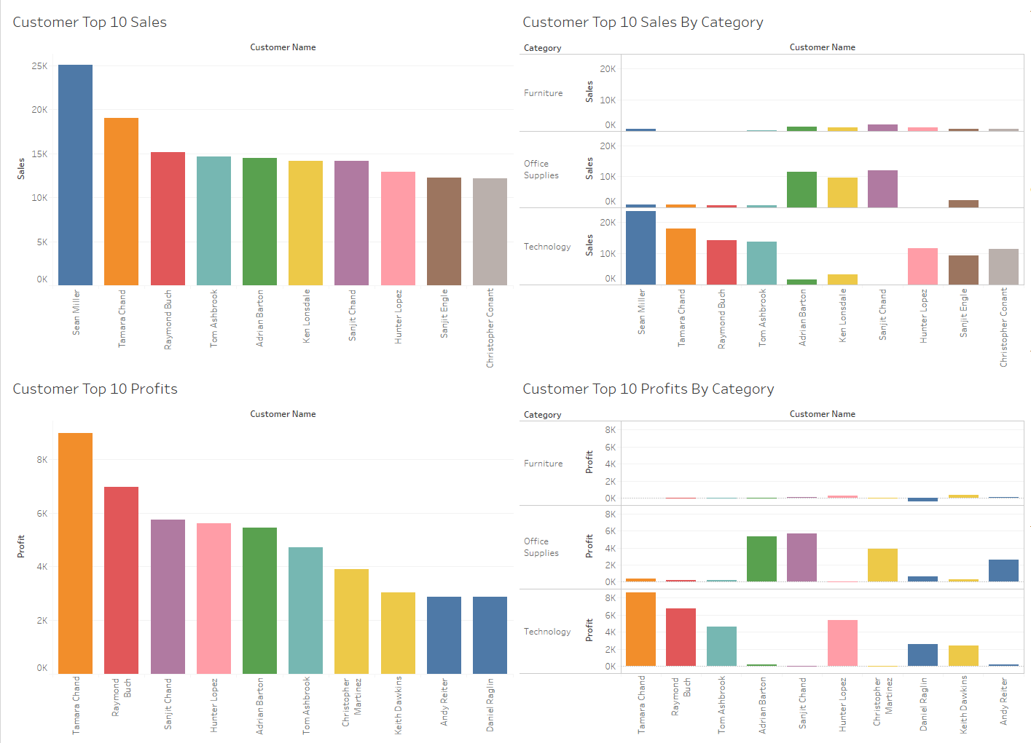
Top 10 Customers By Sales & Profit

Slide 27
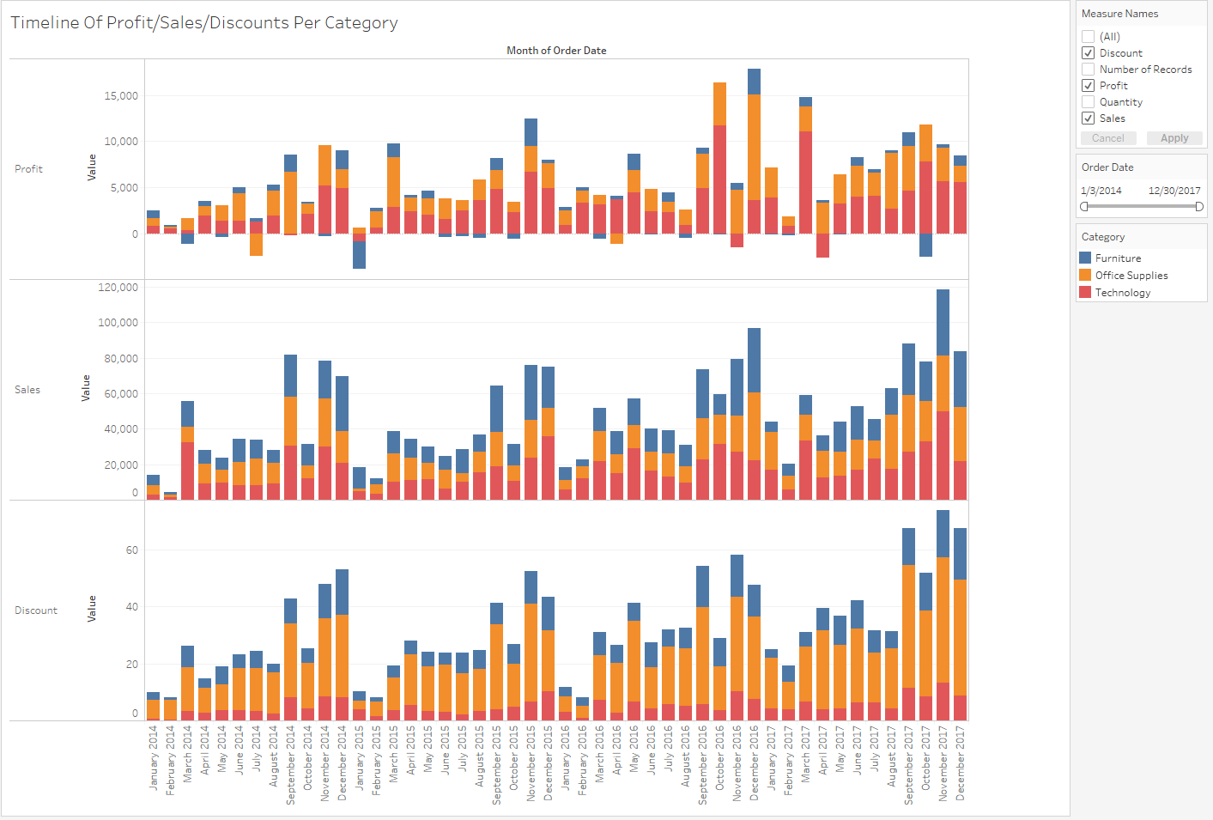
Timeline Comparison Of Profits/Sales/Discounts Per Category

Slide 28
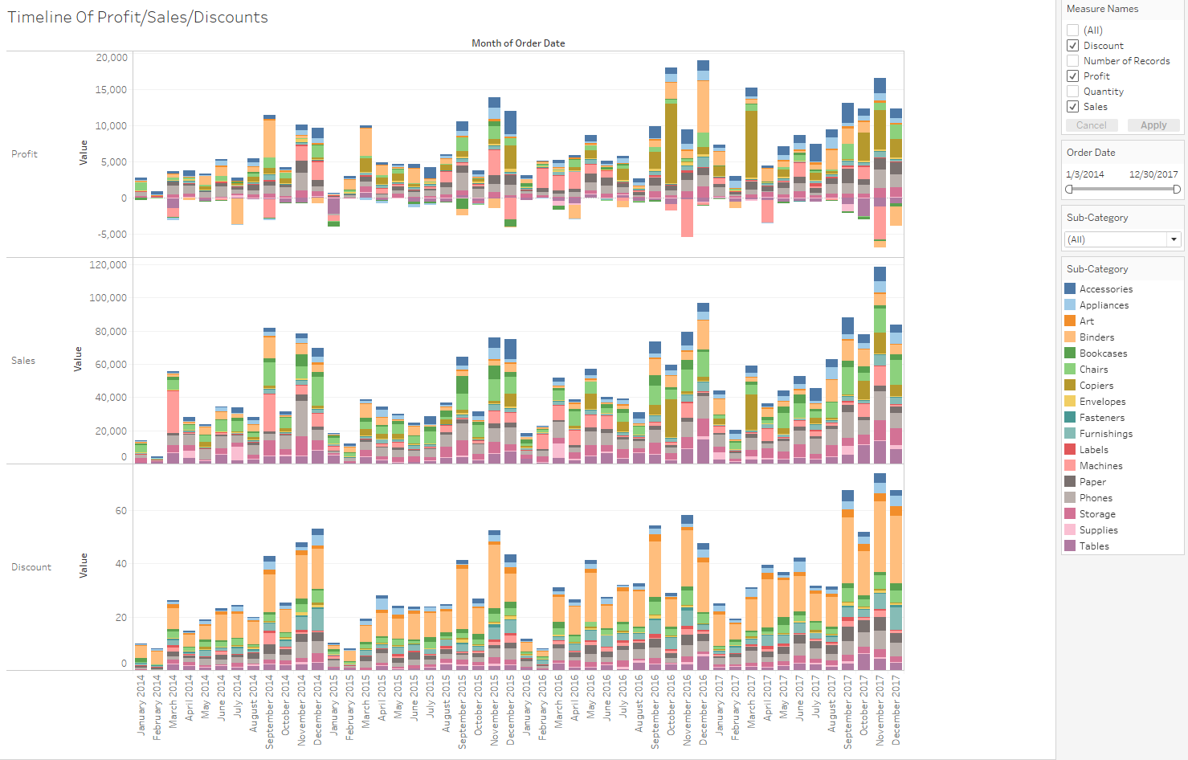
Timeline Comparison Of Profits/Sales/Discounts Per Sub-Category

Slide 29
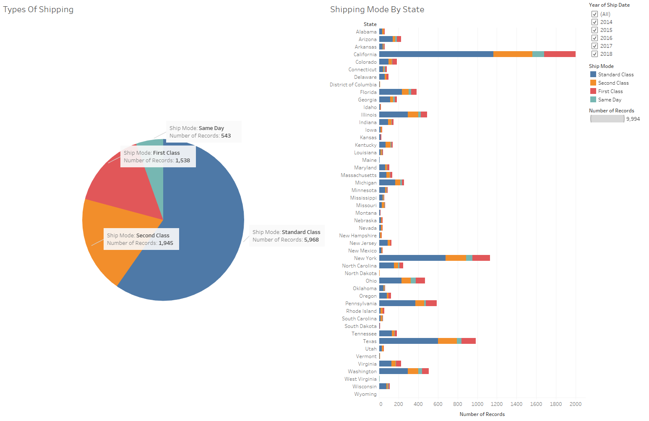
Shipping Mode Information

